Slide 1
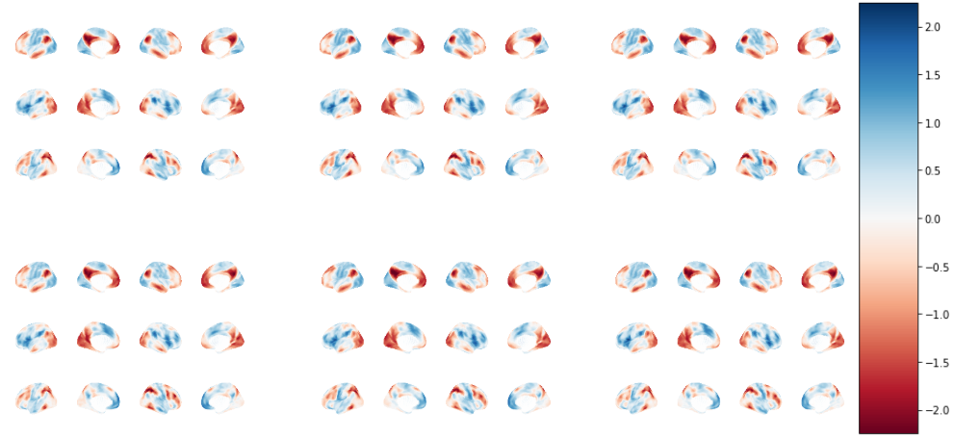
6 Plot
Compassion
Resting State
Open Monitoring
Novice
Expert
Figure 1: Averaged top three gradients computed by gCCA for each trait and state combination.

Slide 2
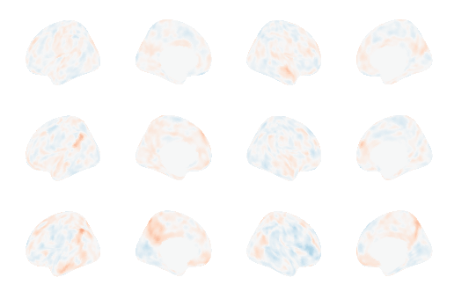
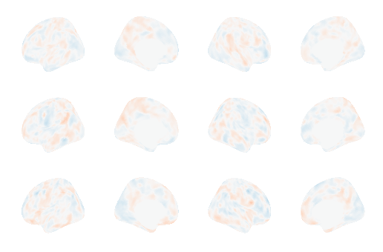
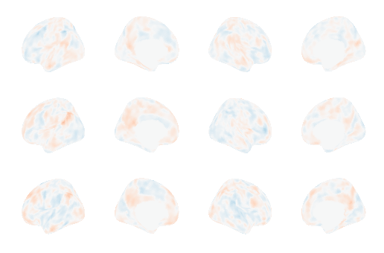
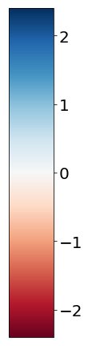
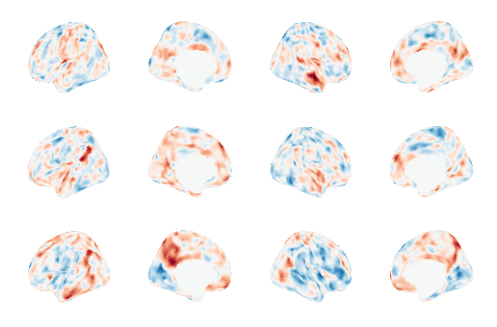
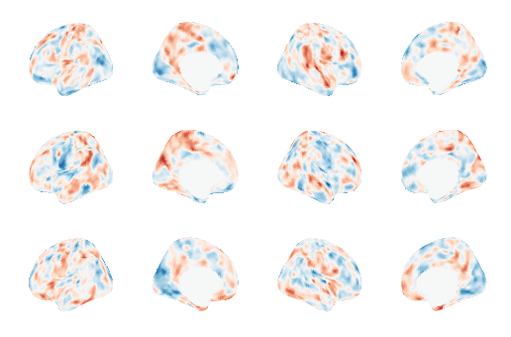
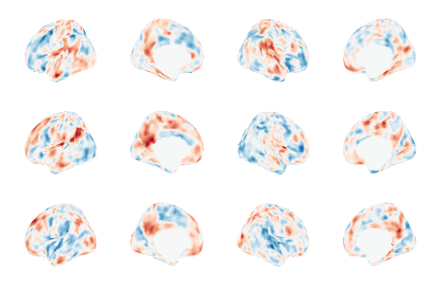
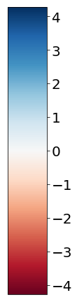
6 Plot Differences
Compassion
Resting State
Open Monitoring
Raw Scale
Normalized by pooled sample std

Slide 3
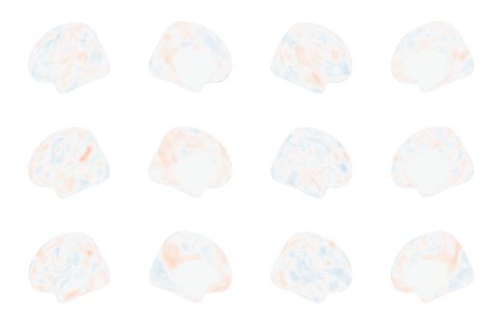
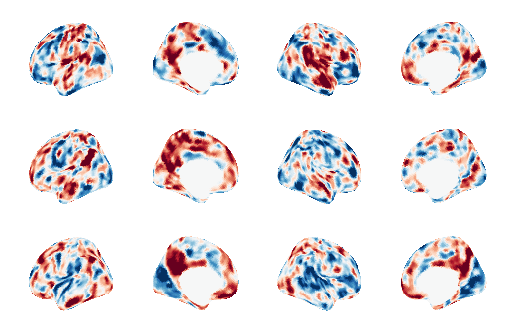
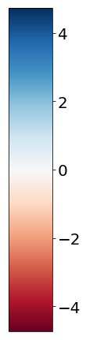
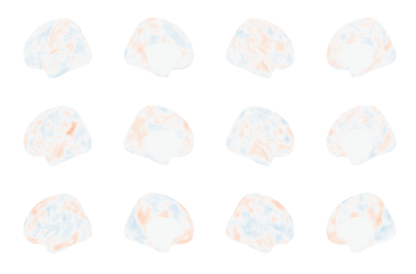
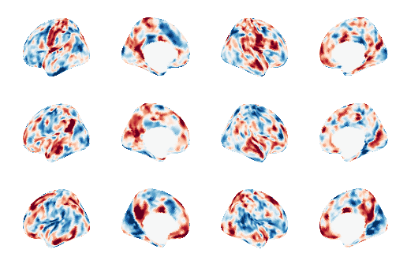
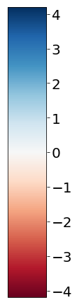
Group Effects
All Experts vs. All Novices
(Raw Scale)
All Experts vs. All Novices
(Normalized by pooled sample std)
Meditating Experts vs. Resting Novices
(Raw Scale)
All Experts vs. All Novices
(Normalized by pooled sample std)

